Slide 1
ENSEMBLE MACHINE LEARNING APPROACH TO CARDIOVASCULAR DISEASES PREDICTION
By
Usman Abdullahi Musa
SPS/CSC/MSC/18/0006
Supervisor:
Dr. Muhammad Sirajo Aliyu (FNCS,MCPN)

Slide 2
INTRODUCTION
Cardiovascular diseases are conditions that affect the structures or function of your heart (Steinbaum, 2019).
Common risk factors includes; age, unhealthy diet, hypertension, diabetes e.t.c (Emakhu et al., 2020; WHO, 2019).
CVD is responsible for 11% of over 2 million NCD deaths in Nigeria annually.
Electronic health record (EHR) systems makes the use of strong analysis tools necessary.
Ensemble models are an ensemble learning method that combines different algorithms together.

Slide 3
BACKGROUND OF THE STUDY
Increasing the efficiency of diagnosis and reduce the misclassification cost (Dandona et al., 2017), enhancing the selection of features(attributes) (Jothi Prakash & Karthikeyan, 2021) and relationship between certain factors to the presence of heart disease (Muibideen & Prasad, 2020) .
Bayesian Network (Muibideen & Prasad, 2020)
AdaBoost, Bagging, Random Forest, and Voting Ensemble (Decision Trees, Logistic Regression and Support Vector Machines) ). (Emakhu et al., 2020)
Bayesian is Computationally expensive (Ivens, 1983)..
Single machine may get stuck in local optima (Dietterich, 2000).
High number of feature/attributes needs dimensionality reduction (Lidy & Rauber, 2008).

Slide 4
PROBLEM STATEMENT
There is need for further study in reduction of the dimensionality in heart disease dataset and the use of multiple classifiers to achieve better performance

Slide 5
AIM AND OBJECTIVE OF THE STUDY
Aim
Develop an accurate and fast ensemble method for prediction of heart disease.
Objectives:
Study the best performing models in heart disease prediction.
Combine the strength of the models
Compare results obtained from the ensemble model with other models

Slide 6
SIGNIFICANCE OF THE STUDY
As heart disease has become is a silent epidemic, accurate and timely prediction of heart disease is important. This will help in reduction in the cost of treatment, loss of life and also increases the chances of recovery.

Slide 7
SIGNIFICANCE OF THE STUDY
As heart disease has become is a silent epidemic, accurate and timely prediction of heart disease is important. This will help in reduction in the cost of treatment, loss of life and also increases the chances of recovery.

Slide 8
SCOPE AND LIMITATION OF THE STUDY
Scope
This study covers the use of structured tabular data on supervised machine learning algorithms to accurately predict the risk of the presence of heart disease in a person.
Limitation
The Study does not include the use of heart image data to make prediction on the presence of heart disease in a person

Slide 9
LITERATURE REVIEW
S/N | Title | Author | Method Used | Evaluation Metrics | Weakness
 | A fast algorithm for heart disease prediction using Bayesian network model | Mistura Muibideen and Rajesh Prasad -2020 | Bayesian network (BN) | Accuracy, Precision, Recall, F1 Score | Bayesian Network requires a comparatively large amount of effort to be able to learn patterns in data. Bayesian learning is extremely computationally expensive
2. | Coronary Artery Disease Diagnosis; Ranking the Significant Features Using Random Trees Model | Javad Hassannataj Joloudari , et al. -2020 | Random Trees, Decision Trees, support vector machine (SVM) | Accuracy, ROC curve, Gini, Gain and Confidence | The model used (Decision Tree) is easily leads to overfitting of the data that are particularly noisy
3. | An Efficient Convolutional Neural Network for Coronary Heart Disease Prediction | Aniruddha Dutta, Tamal Batabyal, Meheli Basu, Scott T. Acton -2020 | Convolutional Neural Network (CNN) | AUC | The training process takes a lot of time on non-GPU systems. It also requires a large Dataset to process and train the neural network
4. | Early Prediction of Heart Disease Using PCA and Hybrid Genetic Algorithm with k-Means | Md. Touhidul Islam, Sanjida Reza Rafa, Md. Golam Kibria -2021 | K-Means with PCA and Hybrid Genetic Algorithm | Accuracy, Clustering Error, Recall, Precision,F1 Score | K-Means has a tendency of been trapped at the local optimum and GAs has a tendency to converge towards local optima or even arbitrary points rather than the global optimum of the problem

Slide 10
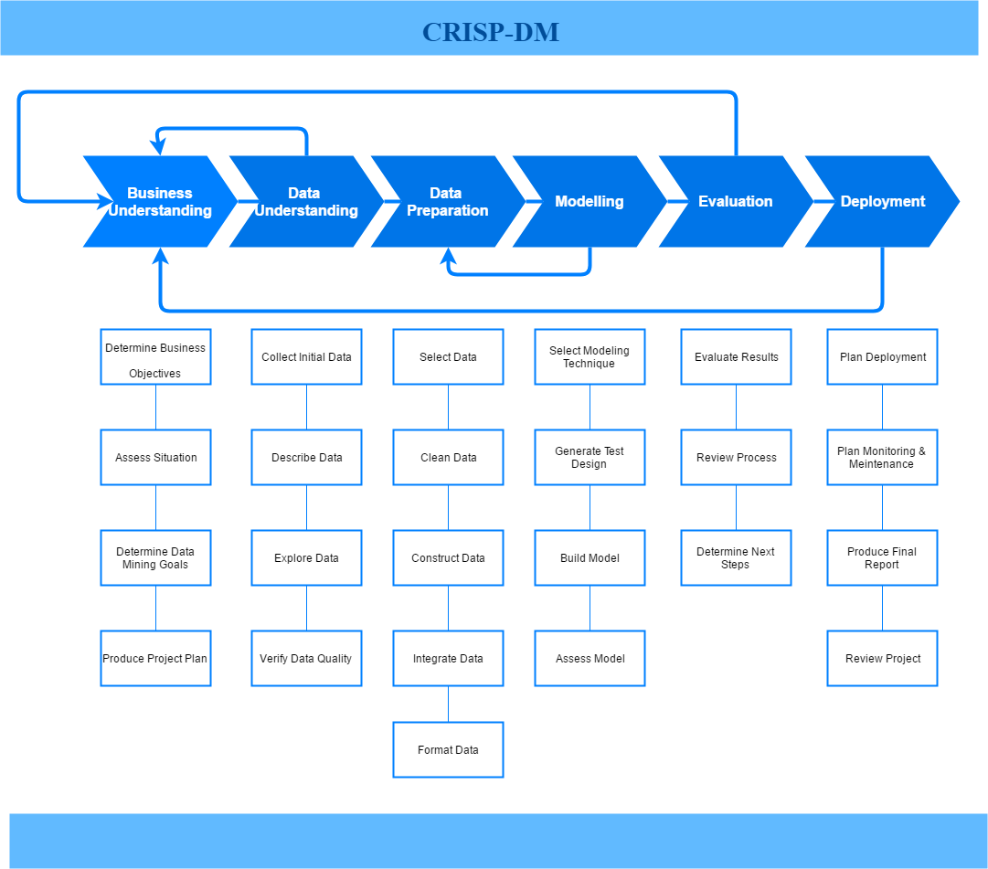
METHODOLOGY
CRISP-DM

Slide 11
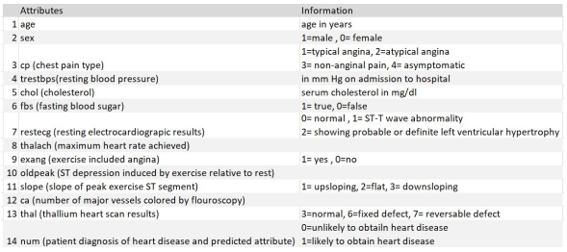
METHODOLOGY cont..
Business Understanding
A good heart disease prediction system
Data Understanding
Data retrieval and Exploratory Data Analysis
This data set contains 14 total attributes of patient medical information for 303 patients. The figure below shows the chosen attributes, and its information.

Slide 12
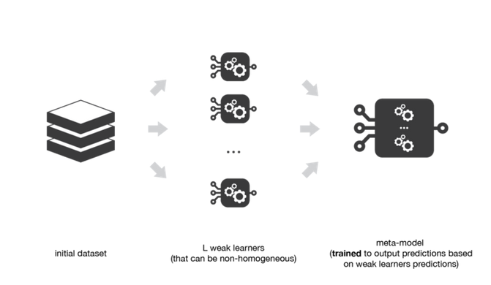
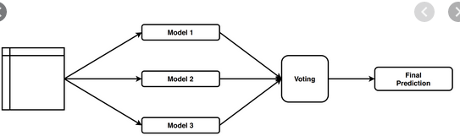
METHODOLOGY cont…
Data preparation
Handling missing values (Rows deltion, Mean/Mode etc)
Feature Selection (Recursive Feature Elimination)
Target class transformation and
Data discretization
Modeling
Random Forest Classifier,
Multilayer perceptron (MLP) and
Naïve Bayes
Evaluation Metrics
Confusion Matrix
Accuracy
Precision
Recall
F1 Score
Deployment
GitHub repository

Slide 13
REFERENCES
Almustafa, K. M. (2020). Prediction of heart disease and classifiers’ sensitivity analysis. BMC Bioinformatics, 21(1), 1–18. https://doi.org/10.1186/s12859-020-03626-y
Dandona, L., Dandona, R., Kumar, G. A., Shukla, D. K., Paul, V. K., Balakrishnan, K., Prabhakaran, D., Tandon, N., Salvi, S., Dash, A. P., Nandakumar, A., Patel, V., Agarwal, S. K., Gupta, P. C., Dhaliwal, R. S., Mathur, P., Laxmaiah, A., Dhillon, P. K., Dey, S., … Swaminathan, S. (2017). Nations within a nation: variations in epidemiological transition across the states of India, 1990–2016 in the Global Burden of Disease Study. The Lancet, 390(10111), 2437–2460. https://doi.org/10.1016/S0140-6736(17)32804-0
Dietterich, T. G. (2000). Ensemble methods in machine learning. Lecture Notes in Computer Science (Including Subseries Lecture Notes in Artificial Intelligence and Lecture Notes in Bioinformatics), 1857 LNCS, 1–15. https://doi.org/10.1007/3-540-45014-9_1
Emakhu, J., Shrestha, S., & Arslanturk, S. (2020). Prediction system for heart disease based on ensemble classifiers. Proceedings of the International Conference on Industrial Engineering and Operations Management, August, 2337–2347.
Gao, X. Y., Amin Ali, A., Shaban Hassan, H., & Anwar, E. M. (2021). Improving the Accuracy for Analyzing Heart Diseases Prediction Based on the Ensemble Method. Complexity, 2021. https://doi.org/10.1155/2021/6663455
Ivens, G. P. (1983). Chemical process dynamics. The Chemical Engineering Journal, 27(2), 120–121. https://doi.org/10.1016/0300-9467(83)80063-x
Jothi Prakash, V., & Karthikeyan, N. K. (2021). Enhanced Evolutionary Feature Selection and Ensemble Method for Cardiovascular Disease Prediction. Interdisciplinary Sciences: Computational Life Sciences, 0123456789. https://doi.org/10.1007/s12539-021-00430-x
Leon, F., Floria, S. A., & Badica, C. (2017). Evaluating the effect of voting methods on ensemble-based classification. Proceedings - 2017 IEEE International Conference on INnovations in Intelligent SysTems and Applications, INISTA 2017, July, 1–6. https://doi.org/10.1109/INISTA.2017.8001122

Slide 14
REFERENCES
Lidy, T., & Rauber, A. (2008). Machine Learning Techniques for Multimedia. Machine Learning Techniques for Multimedia, 11, 249–285. https://doi.org/10.1007/978-3-540-75171-7
Loyola-Gonzalez, O. (2019). Black-box vs. White-Box: Understanding their advantages and weaknesses from a practical point of view. IEEE Access, 7, 154096–154113. https://doi.org/10.1109/ACCESS.2019.2949286
Muibideen, M., & Prasad, R. (2020). A Fast Algorithm for Heart Disease Prediction using Bayesian Network Model. 1–11. http://arxiv.org/abs/2012.09429
Sai Shekhar, M., Mani Chand, Y., & Mary Gladence, L. (2021). Heart Disease Prediction Using Machine Learning. Lecture Notes in Electrical Engineering, 708(Inccst 20), 603–609. https://doi.org/10.1007/978-981-15-8685-9_63
Steinbaum, S. R. (2019). Cardiovascular (Heart) Diseases: Types and Treatments. https://www.webmd.com/heart-disease/guide/diseases-cardiovascular
Usha Sri, B. (2020). Effective Heart Disease Prediction Model Through Voting Technique. International Journal of Engineering Technology and Management Sciences, 4(5), 10–13. https://doi.org/10.46647/ijetms.2020.v04i05.003
WHO. (2019). WHO and Nigerian Government move to curb cardiovascular diseases | WHO | Regional Office for Africa. https://www.afro.who.int/news/who-and-nigerian-government-move-curb-cardiovascular-diseases

Slide 15
THANK YOU FOR LISTENING

